Slide 1
NATIONAL HYDROLOGY PROJECT
A World Bank Assisted Central Scheme for Transforming the Water Sector
World Bank Mission : Phase III – Bengaluru, Karnataka
17th – 18th June, 2022

Slide 2
Introduction to NHP
PROJECT OBJECTIVE
To improve the
extent
reliability
accessibility of water resources information &
strengthen the capacity of targeted water resources management institutions in India
Better Water Resources Development and Management in the country
Components of NHP
Financial support (Central Scheme-100% grant to Implementing agencies)
Budget: INR 3680 Crore; World Bank Loan: USD 160 million ;
Duration: 8 years (2016-2024);
Water Resources Monitoring System
Water Resources Information System
Water Resources Operation & Planning System
Institutional Capacity Enhancement

Slide 3
Challenges in the Water Sector to be addressed by NHP
Non availability of high frequency data required for extreme event design & management
Dependence on cost prohibitive imported technology and equipment
Availability of Data in various formats from various sources
Absence of centralised data base
Absence of water data in public domain in India
Dependence on manual monitoring system reeling with man power shortage
Latency in availability of data

Slide 4
Challenges in the Water Sector to be addressed by NHP
Non sharing of data
Management of Water based on administrative units
Limited use of space technologies in water resources management
Lack of capacity to use modern analytical tools required for informed decision making
Limited demonstrative examples of Integrated Reservoir Operation
Limited understanding of river morphology associated erosion and siltation issues
Flood forecasting lead time limited to 24 hrs without likely inundation information

Slide 5
Domain of Activities
Real Time Data Acquisition System (RTDAS) – River/ Reservoir Water Level, Ground Water level, Rainfall, Weather parameters
Supervisory Control and Data Acquisition (SCADA) – Monitoring and Operation of dams, barrages and canals on pilot basis
Purpose Driven Studies (PDS) – Implementable solution to regional/ localised problems
Digital Elevation Model of various configuration, Geo Data Base, Establishment of Continuous Operating Reference Stations, Geoid models – used for inundation modelling, flood plain zoning, Decision Support System
State of the art Instrumentation for hydro-met observations, water quality, IT, Surveying etc – Adoption of modern technologies

Slide 6
Domain of Activities
Studies/Knowledge products
Tools for water resources assessment
Extended Hydrologic Prediction - For seasonal forecast at reservoirs in Yamuna, Narmada and Kaveri Basins
Integrated Reservoir Operation in Ganga and Narmada Basin, DVC system
Studies for Sediment Transport and Management
Snowmelt Forecast
Glacial Lake Risk Assessment and Glacial Lake Outburst Flood (GLOF)
Shoreline Management Plan- Goa
Reservoir Sedimentation Studies
Springs inventory, monitoring & rejuvenation
Census of GW extraction structure in different category of pilot blocks of Odisha and developing a web based application
Delineation of aquifers, estimation of aquifer hydraulic parameters

Slide 7
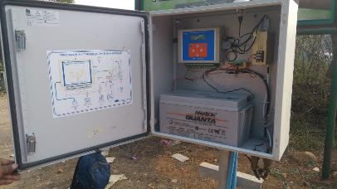
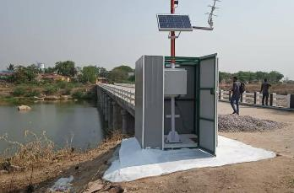
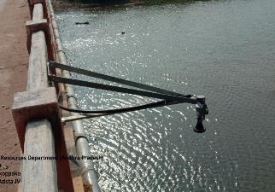
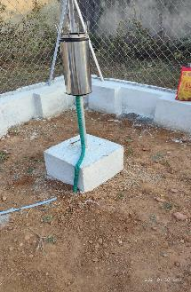
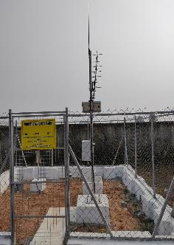
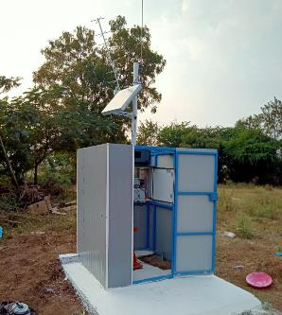
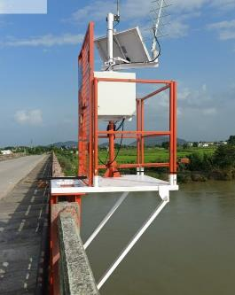
RTDAS Installations

Slide 8
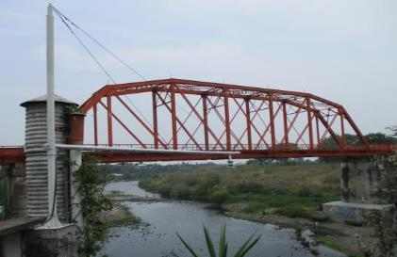
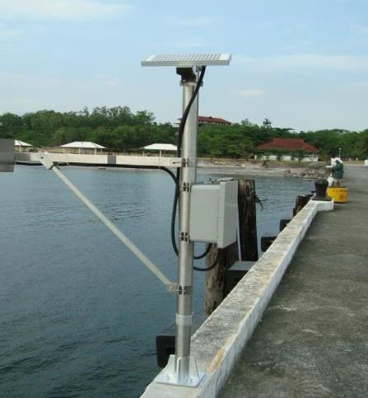
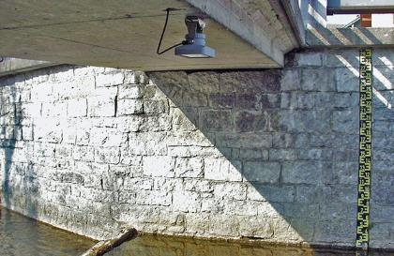
RTDAS Installations

Slide 9
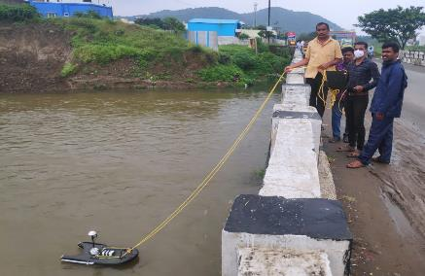
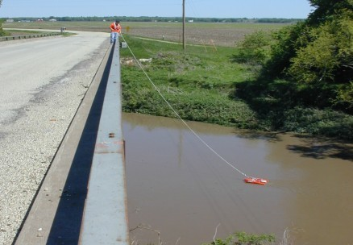
Reservoir sedimentation survey and ADCP for discharge measurement

Slide 10
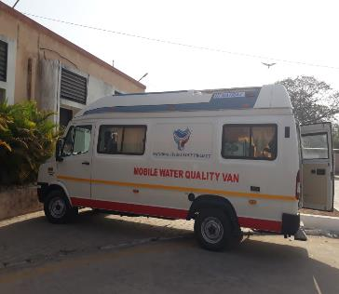
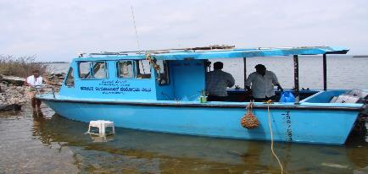
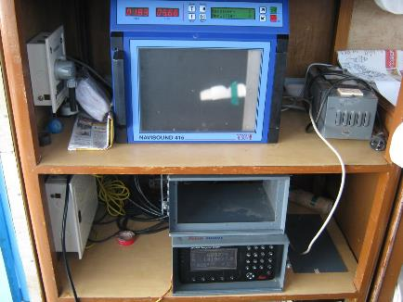
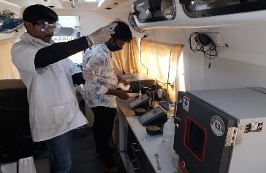
Water Quality Monitoring
Bathymetric Survey

Slide 11
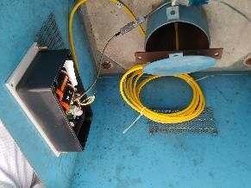
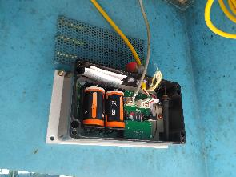
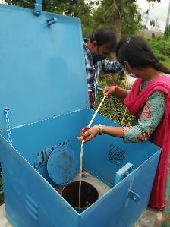
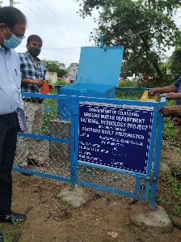
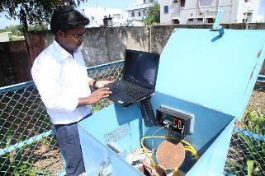
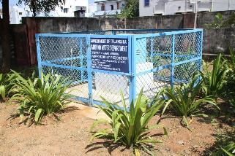
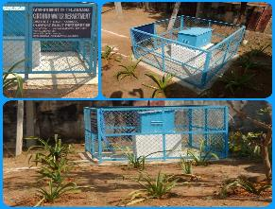
GW Monitoring Stations
Telangana

Slide 12
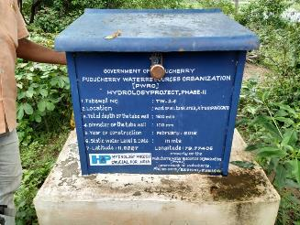
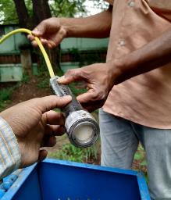
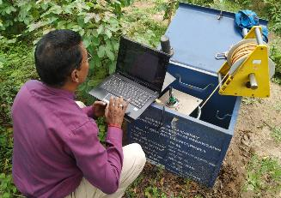
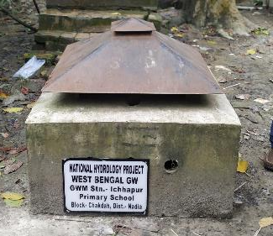
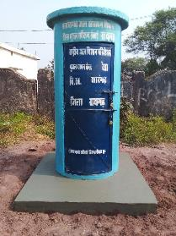
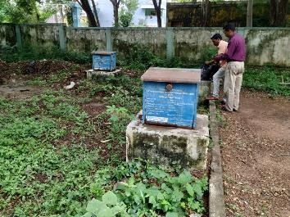
GW Monitoring Stations

Slide 13
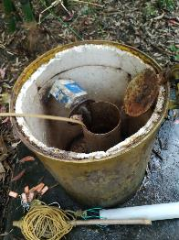
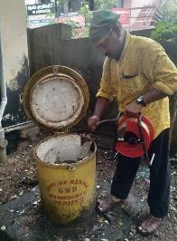
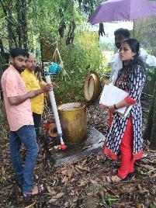
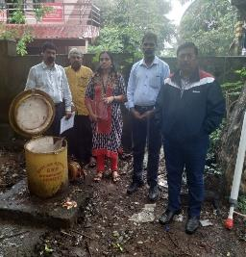
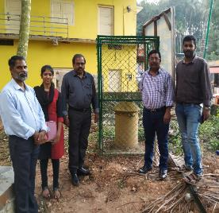
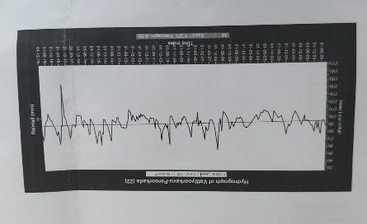
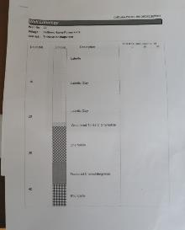
Technical Audit of GW Monitoring Stations
KERALA

Slide 14
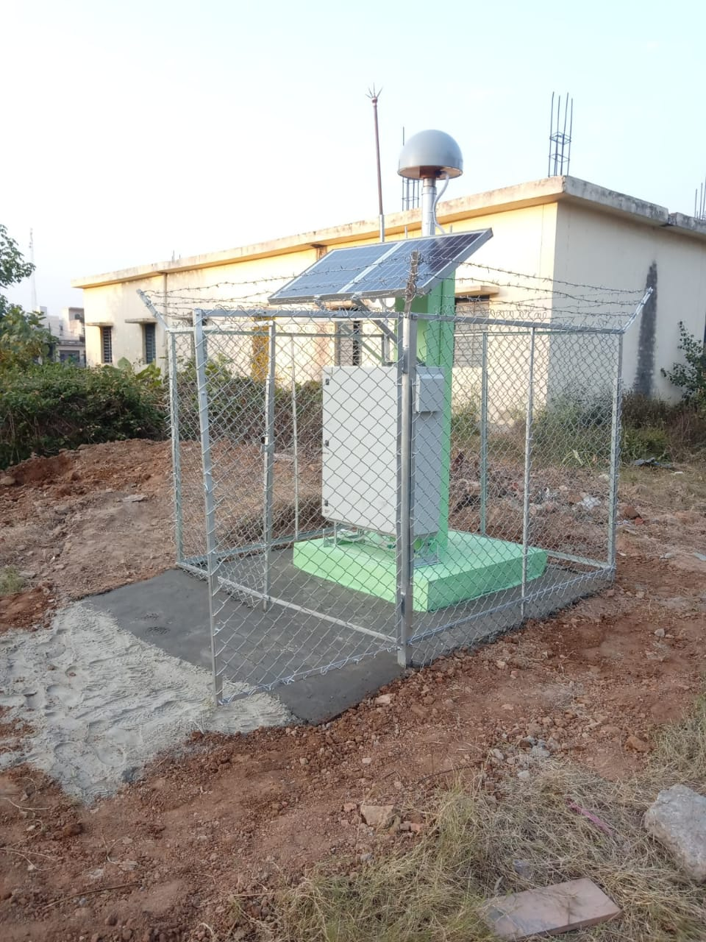
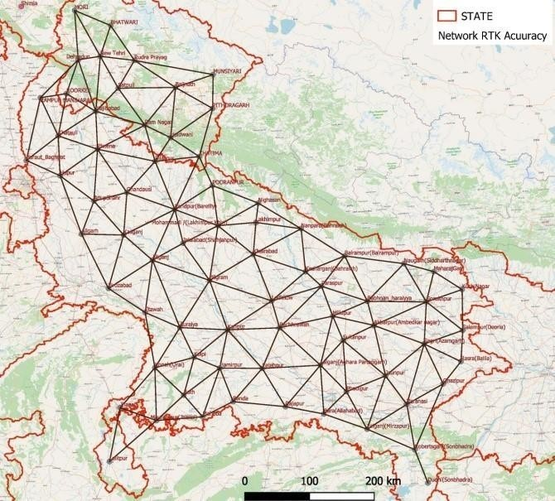
CORS Station and Network:
CORS Network in UP & UK 1
CORS station

Slide 15
Summary of cumulative Progress under Major heads:
Sl. No. | Activity |  | Overall target (nos.) | Progress upto March'20 | Progress upto March'21 | Progress during 2021-22 | Progress upto March'22 | Progress during FY 2022-23 | Overall Progress till date
1 | RTDAS-SW (nos.) | Award of contract | 6214 | 1159 | 3249 | 1001 | 4250 | 206 | 4456
 |  | Installation of stn |  | 83 | 590 | 1602 | 2192 | 313 | 2505
 |  | Sharing of data in WIMS |  |  | 407 | 1415 | 1822 | 388 | 2210
2 | RTDAS-GW (nos.) | Award of contract | 16417 | 1868 | 4868 | 5360 | 10228 | 2736 | 12964
 |  | Installation of stn |  | 25 | 2072 | 2340 | 4412 | 472 | 4884
 |  | Sharing of data in WIMS |  |  | 1222 | 2119 | 3341 | 532 | 3873
3 | Piezometer (nos.) | Award of contract | 5840 | 847 | 1932 | 1298 | 3230 | 167 | 3397
 |  | Construction of PZ |  | 202 | 1039 | 1759 | 2798 | 79 | 2877
4 | SCADA (nos.) | Award of contract | 57 | 4 | 24 | 10 | 34 | 2 | 36
 |  | Commissionioning of SCADA |  | 1 | 3 | 7 | 10 | 1 | 11
5 | Data Centre (nos.) | Award of contract | 38 | 16 | 25 | 10 | 35 | 0 | 35
 |  | Construction of Data Centre |  | 6 | 8 | 13 | 21 | 0 | 21
6 | ADCP (nos.) | Award of contract | 185 | 16 | 56 | 39 | 95 | 91 | 186
 |  | Procurement of ADCP |  | 16 | 56 | 39 | 95 | 3 | 98
7 | Water Quality Equipment packages (nos.) | Award of contract | 221 | 1 | 12 | 97 | 109 | 79 | 188
 |  | Commissioning of packages |  | 1 | 12 | 97 | 109 | 79 | 188
8 | Purpose Driven Studies (nos.) | Award of contract | 40 | 36 | 40 | NA | 40 | NA | 40
 |  | Completion of PDS |  |  | 1 | 21 | 22 | 0 | 22
9 | Studies/ Knowledge Products (nos.) | Award of studies/KP/DSS | 206 | 26 | 65 | 44 | 109 | 29 | 138
 |  | Completion of studies/KP/DSS |  | 1 | 5 | 20 | 25 | 1 | 26

Slide 16
Overall Progress of RTDAS - SW & GW – Award, Installation & Data Sharing
Type | Proposed Hydromet (nos.) | Awarded | Floated | Installed | Sharing data in WIMS
Surface water | 6222 | 4456 | 1589 | 2505 | 2210
Ground water | 16417 | 12964 | 3393 | 4884 | 3873
Total | 22639 | 17420 | 4982 | 7389 | 6083

Slide 17
Status of Implementation - Hydromets
Surface Water RTDAS
Sl No. | Details: (In Numbers) | Upto March, 2020 | 2020-21 | 2021-22 | Progress upto March’22 | Current FY 2022-23
 |  |  |  |  |  | Target for the Year | Achievement
1 | Contract Awarded | 1159 | 2090 | 1001 | 4250 | 1964 | 206 (Floated – 1589)
2 | Stations Installed | 83 | 507 | 1602 | 2192 | 4041 | 313
3 | Stations integrated with WIMS | 0 | 407 | 1415 | 1822 | 3822 | 388
Ground Water RTDAS
Sl No. | Details: (In Numbers) | Upto March, 2020 | 2020-21 | 2021-22 | Progress upto March’22 | Current FY 2022-23
 |  |  |  |  |  | Target for the Year | Achievement
1 | Contract Awarded | 1868 | 3000 | 5360 | 10228 | 6189 | 2736 (Floated – 3393)
2 | Stations Installed | 25 | 2047 | 2340 | 4412 | 12005 | 472
3 | Stations integrated with WIMS | 0 | 1222 | 2119 | 3341 | 11219 | 532

Slide 18
Overall Progress of SCADA
Type | Proposed SCADA (nos.) | Awarded | Floated | Reviewed by NPMU/ TAMC | Commissioned
SCADA | 57 | 36 | 18 | 3 | 11
Projects | Upto March, 2020 | 2020-21 | 2021-22 | Progress upto March’22 | Current Financial Year 2022-23
 |  |  |  |  | Target for the Year | Achievement
Contract Awarded | 4 | 21 | 9 | 34 | 23 | 2 (Floated – 18)
Installed/ Commissioned | 1 | 2 | 7 | 10 | 42 | 1

Slide 19
Overall Progress of ADCP
Type | Proposed (nos.) | Awarded | Floated | Procured
ADCP | 195 | 186 | 9 | 98
Projects | Upto March, 2020 | 2020-21 | 2021-22 | Progress upto March’22 | Current Financial Year 2022-23
 |  |  |  |  | Target for the Year | Achievement
Contract Awarded | 16 | 40 | 39 | 95 | 86 | 91
Procured | 16 | 40 | 39 | 95 | 86 | 3

Slide 20
Overall Progress of Data Centre
Type | Proposed (nos.) | Awarded | Floated | Completed
Data Centre | 38 | 35 | 3 | 21
Projects | Upto March, 2020 | 2020-21 | 2021-22 | Progress upto March’22 | Current Financial Year 2022-23
 |  |  |  |  | Target for the Year | Achievement
Contract Awarded | 16 | 9 | 10 | 35 | 3 | -
Constructed | 6 | 2 | 13 | 21 | 17 | -

Slide 21
Overall Progress of PDS
Type | Proposed (nos.) | Awarded | Completed
PDS | 40 | 40 | 22
Projects | Upto March, 2020 | 2020-21 | 2021-22 | Progress upto March’22 | Current Financial Year 2022-23
 |  |  |  |  | Target for the Year | Achievement
Contract Awarded | 36 | 4 | - | 40 | - | -
Completed | - | 1 | 21 | 22 | 13 | -

Slide 22
Overall Progress of Studies/Knowledge Products
Type | Proposed (nos.) | Awarded | Floated | Completed
Studies/KP | 206 | 138 | 22 | 26
Projects | Upto March, 2020 | 2020-21 | 2021-22 | Progress upto March’22 | Current Financial Year 2022-23
 |  |  |  |  | Target for the Year | Achievement
Contract Awarded | 26 | 30 | 53 | 109 | 62 | 29
Completed | 1 | 4 | 20 | 25 | 71 | 1

Slide 23
Status of Procurement and Expenditure
till 15th June

Slide 24
Financial Progress Summary - Year Wise

Slide 25
NHP-Major headwise PIP Allocation and Expenditure

Slide 26
Monthly Ranking of IAs - May 2022
State Agencies, UTs, RBOs excluding North East agencies including Assam (33 nos.):
Agency-wise Monthly Ranking – May 2022
Agency Name | Total marks | Ranking
Uttar Pradesh GW | 83.82 | 1
Andhra Pradesh GW | 82.38 | 2
DVC | 76.91 | 3
Kerala SW | 76.08 | 4
Telangana GW | 72.68 | 5
Haryana | 71.43 | 6
Gujarat | 64.24 | 7
Bihar SW | 63.50 | 8
Madhya Pradesh | 62.76 | 9
Rajasthan | 61.61 | 10
Chhattisgarh | 60.63 | 11
Assam | 59.62 | 12
Tamil Nadu | 59.25 | 13
Kerala GW | 57.86 | 14
NCA | 57.40 | 15
Andhra Pradesh SW | 54.78 | 16
Himachal Pradesh | 54.31 | 17
Agency-wise Monthly Ranking – May 2022
Agency Name | Total marks | Ranking
West Bengal SW | 54.09 | 18
Punjab | 53.93 | 19
Karnataka | 52.82 | 20
Uttarakhand | 50.52 | 21
Maharashtra SW | 49.97 | 22
Goa | 44.39 | 23
Odisha | 42.19 | 24
Jharkhand | 41.33 | 25
Uttar Pradesh SW | 39.18 | 26
Telangana SW | 38.77 | 27
Bihar GW | 37.61 | 28
West Bengal GW | 36.95 | 29
Puducherry | 28.11 | 30
Maharashtra GW | 26.30 | 31
BBMB | 18.77 | 32
Delhi | 9.07 | 33

Slide 27
Monthly Ranking of IAs- May 2022
North East Agencies excluding Assam (6 Nos.):
Central Agencies (8 Nos.):
Agency-wise Monthly Ranking – May 2022
Agency Name | Total marks | Ranking
Sikkim | 92.12 | 1
Nagaland | 69.81 | 2
Meghalaya | 68.05 | 3
Mizoram | 65.06 | 4
Manipur | 60.08 | 5
Tripura | 51.03 | 6
Agency-wise Monthly Ranking – May 2022
Agency Name | Total marks | Ranking
NRSC | 79.48 | 1
SOI | 73.20 | 2
NIH | 68.15 | 3
CWC | 55.04 | 4
CWPRS | 51.85 | 5
CGWB | 44.19 | 6
NWIC | 40.47 | 7
CPCB | 31.92 | 8

Slide 28
Challenges in the Water Sector vis a vis Role of NHP
Challenges in the Water Sector | Initiative under NHP
Non sharing of data | Central Data Dissemination policy modified. Classified information now available to NHP IAs. Reduced trust deficit, States forthcoming in data sharing
Management of Water based on administrative units | Basin scale water resources management
Limited use of space technologies in water resources management | Space technologies being promoted for monitoring, planning and analysis
Lack of capacity to use modern analytical tools required for informed decision making | Institutional Capacity building by involving Institutes of Repute and expertise. Customised training programmes with hands on sessions .
Limited demonstrative examples of Integrated Reservoir Operation | Use of globally recognised tools for Demonstrative IRO at basin scale
Limited understanding of river morphology associated erosion and siltation issues | Physical based mathematical modelling approach is being tested in identified basins. Use of RS based analytical tools
Flood forecasting lead time limited to 24 hrs without likely inundation information | Lead time being improved to 72 hours with inundation mapping

Slide 29
Points needing Attention
Firm plan to achieve targets in time bound manner
Improvement in data quality and regular updating in centralized database
Early operationalization of data centers – IT Infra and deployment of relevant manpower
Establishment of State Water Informatics Centre in close coordination with NWIC
Enrichment of information required for IWCIMS and State WRIS
Effective utilisation of assets created under NHP & to establish mechanism for maintenance of these assets beyond NHP

Slide 30
Thank you

Slide 31
Impacts of NHP
S No. | Parameter | Pre NHP | NHP | Output | Outcome
1 | Centralised Data base – One nation one water database | Non available – System was only for CWC | On line system Available accessible to all Implementing agencies of NHP | Availability of single centralised online water resources data system | Seamless accessibility of data for use and analysis
2 | Availability of RTDAS – SW stations (Water level and Met. Stations) contributing to National data base | 565 | 2082 excluding CWC network | Availability of real time rainfall and water level data from further points in the upstream catchment | Use in extreme event management including reservoir operations apart from development of water accounting and design applications
3 | Availability of RTDAS – GW level stations contributing to National Data Base | 0 | 3627 | Availability of 6-hourly data covering all zones and multiple aquifers | Better understanding of GW regime for effective ground water management

Slide 32
Impacts of NHP
S No. | Parameter | Pre NHP | NHP | Output | Outcome
5 | Data Dissemination policy | Data Dissemination policy -2013 | Modified Data Dissemination policy -2018 | Sharing of classified DOWR Data (except Indus Basin) with NHP agencies with one time secrecy undertaking | Free Central data sharing regime initiated on Govt. to Govt. basis. State of art analytical tools would be developed and tested by various agencies
6 | Improvement in lead time in FF and inundation mapping | Gauge to gauge correlation based forecast of river water levels by the CWC; evacuation based on local experiences | Meteorological forecast based inundation forecast through hydrologic and hydraulic models | Increased lead time for better evacuation planning | Reduction of flood deaths
7 | Irrigation Water Management – Har khet ko Pani | Water release based on schedules, information available on registers only | Irrigation Management System with online sharing of information and stakeholder validation | Improved irrigation efficiency through transparent and responsible governance | Saving of water leading to increased irrigated area and crop production

Slide 33
Impacts of NHP
S No. | Parameter | Pre NHP | NHP | Output | Outcome
8 | Water resources in the NE | Limited technical exposure | Extensive training, initiation of projects covering multiple aspects of the water sector in each state | Projects from inundation forecasting, irrigation development to spring mapping | More development leading to increased linkage of the people of the NE to centre and mainland
9 | SCADA | Very rare for irrigation component | 57 projects proposed so far. 35 under various stages of execution | Reliable and automated operation on rule based optimisation with ultimate target of water accounting and improvement in irrigation efficiency | Reduced chances of failures at odd hours and under extreme conditions, shift from unskilled to skilled manpower
10 | Mobile water quality lab | Hardly any mobile labs exist for source side water quality testing | Mobile water quality labs being procured by IAs as per specific requirement related to testing of raw water from various sources | Water quality testing at site with minimum delay, awareness in stakeholders | Reduction of water borne diseases, improvement of water quality through public pressure

Slide 34
Impacts of NHP
S No. | Parameter | Pre NHP | NHP | Output | Outcome
11 | Use of state of art equipment for discharge measurement | Only by CWC and a couple of states | 99 ADCPs procured so far, Velocity Radars are also being procured by selected IAs. | Faster and more accurate measurement of discharge | More reliable assessment of water resources and flood magnitude
12 | Decision Support system for Integrated Water and Crop Planning | No such system exists on National level | Being developed by NWIC on pan India Basis. | Integrated and smart water assessment and management encompassing surface and ground water | Better water management Reduction in impacts of drought and flood, a step towards water security
13 | Trained manpower to handle modern analytical tools | Only a few experts are there with the State IAs. | Team of departmental domain experts and modellers is being developed | A mix of experienced and young professionals from government departments being trained through customised training programmes and expert faculty. | In house capability for scientific and informed decision making
14 | Spatial Data and land resources associated with water | Available information is scanty and difficult to obtain | Associated with Survey of India and NRSC to get the spatial products developed and integrated on WRIS | DEM/DTM, Geo Data Base, CORS Network, Geiod Model, Glacial Lake Atlas available on India WRIS | Better Management of water resources including extreme event management

